Slide 1
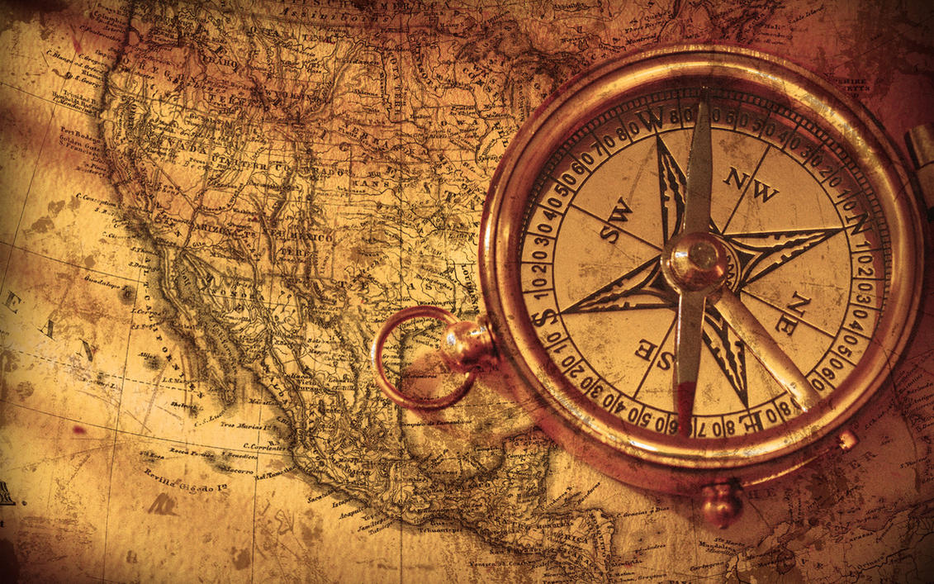
Mapping geodiversity in Texel
Thesis presentation
Minqiu Korevaar
Bsc Future Planet Studies Major Future Earth 25.06.24

Slide 2
Agenda
1. Introductie
2. Methodology
3. Results
4. Discussion
5. Conslusion

Slide 3
What is geodiversity?
Geodiversity
A. Geomorphology Landforms, topography, physical processes
B. Geology Material; rocks, minerals and fossils
C. Lithology Soil types and physical/chemical properties of soils
D. Hydrology Waterbodies; lakes, groundwater
1. Introduction
2. Methodology
3. Results
4. Discussion
5. Conclusion
3
Notes:
Concept of geodiv: Boothroyd et al., 2019; Gray, 2004. 4 components: Gray (2013). Awareness has risen G is fundamental in understanding Earth processes and provid solid foundation for envion manag. Brilha, 2016; Gray, 2008; Knudson et al., 2018.

Slide 4
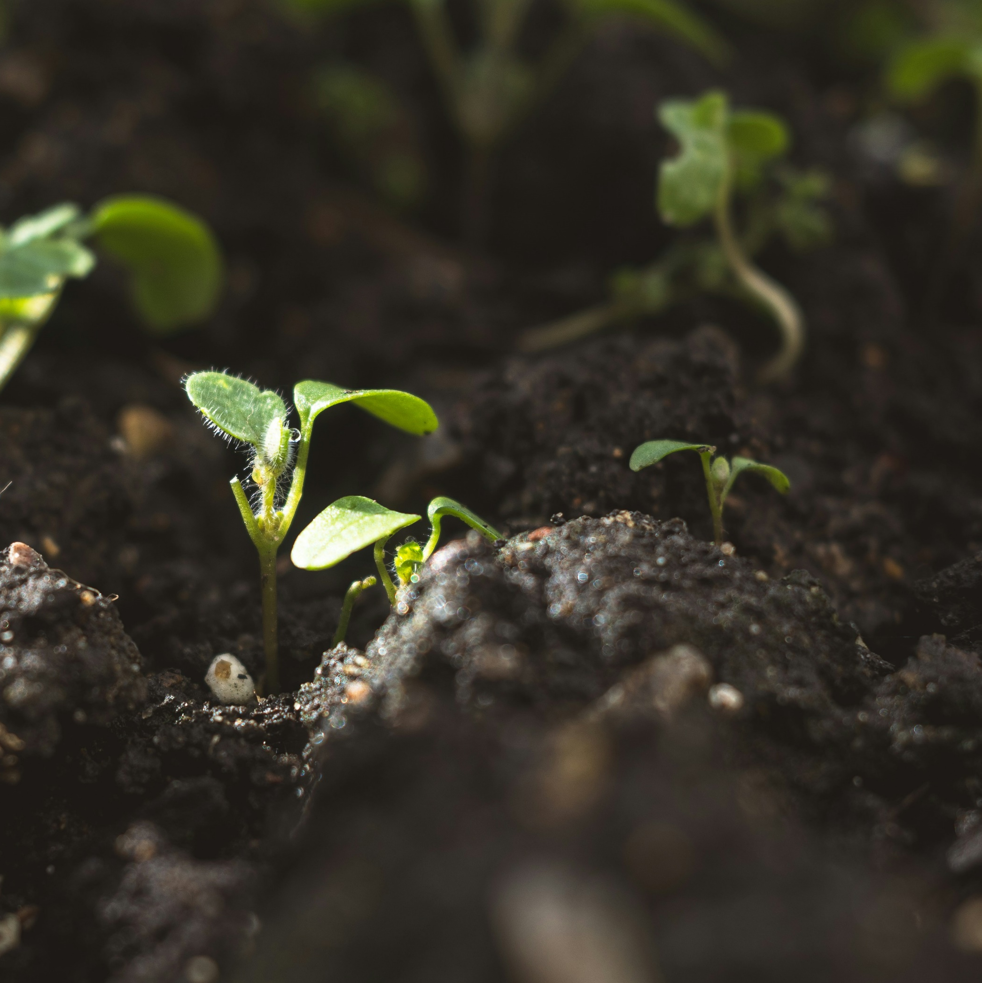

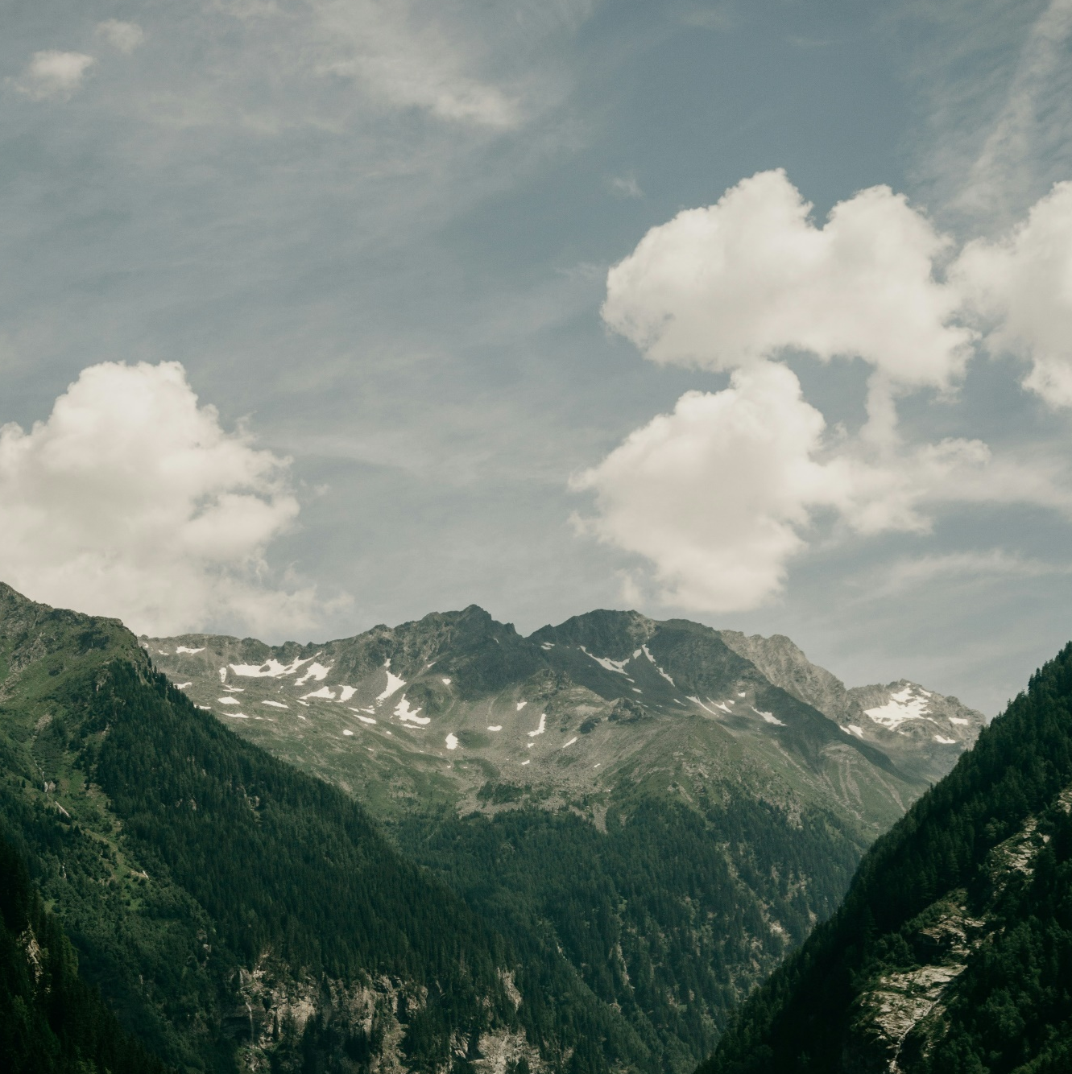
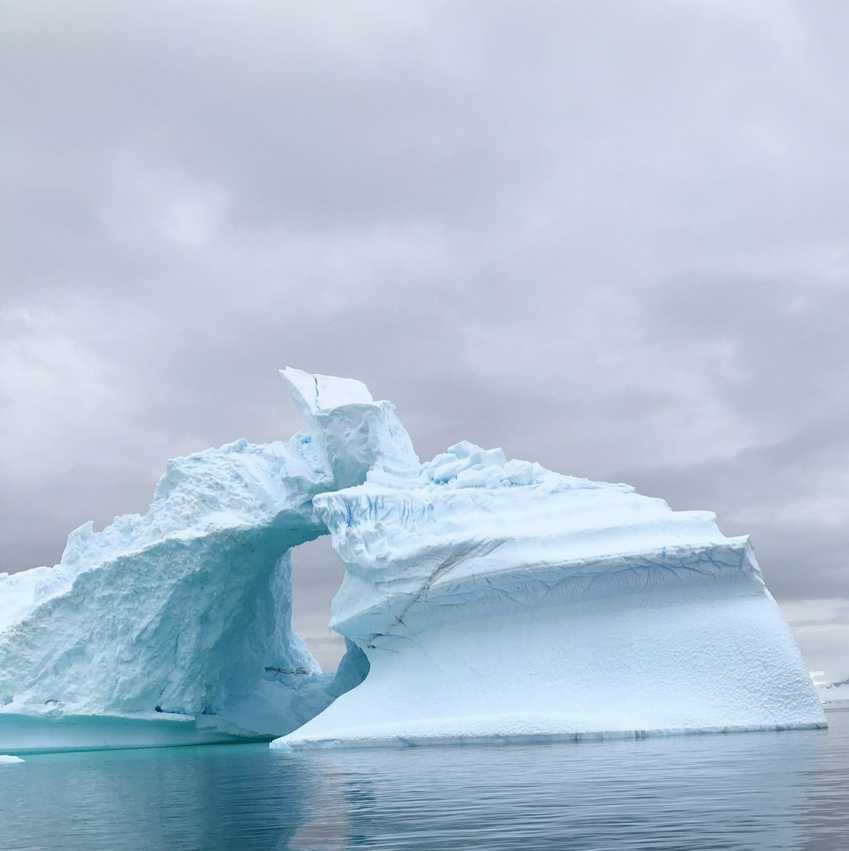
Relevance of geodiversity
Supporting
Provisioning
Ecosystem services
Cultural
Regulating
1. Introduction
2. Methodology
3. Results
4. Discussion
5. Conclusion
4
Notes:
ES benefits hmns receive from nature (Fox et al. 2022). Geodiv contribute to EC by Supp = habitat creation, Prov = Rare earth materials, Reg = reg thermal flows, Cult = aesthetic view (Fox et al. 2022; Gordon & Barron, 2013; Gray, 2013).

Slide 5
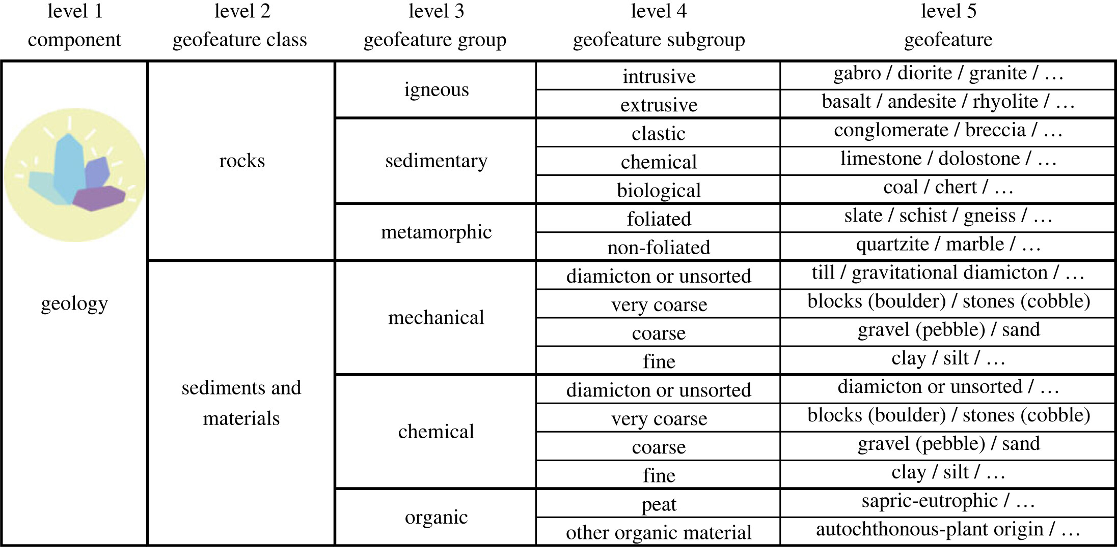
Knowledge gaps
1. No consensus on definition geodiversity and its components
2. No hierarchical mapping methods where scale differences are accurately represented.
Hierarchical mapping
Organizes features into multiple levels of detail (hierarchical) and display the features at different scales in a single map layer (mapping)
Towards a taxonomy of geodiversity, Volume: 382, Issue: 2269, DOI: (10.1098/rsta.2023.0060)
1. Introduction
2. Methodology
3. Results
4. Discussion
5. Conclusion
5
Notes:
1. (Ibáñez & Brevik, 2022; Santos et al., 2017). 2. (Bucci et al., 2022; De Jong et al., 2021; Wielemaker et al., 2001).

Slide 6
Research questions
1. Which taxonomic levels and features of Hjort et al. (2024) are necessary to map geodiversity of Texel island? 2. Which digital cartographic visualization tools and techniques adequately display geofeatures in a hierarchical geodiversity map?
3. What geodiversity components and classes are present in the Hoge Berg and dune area?
1. Introduction
2. Methodology
3. Results
4. Discussion
5. Conclusion
6

Slide 7
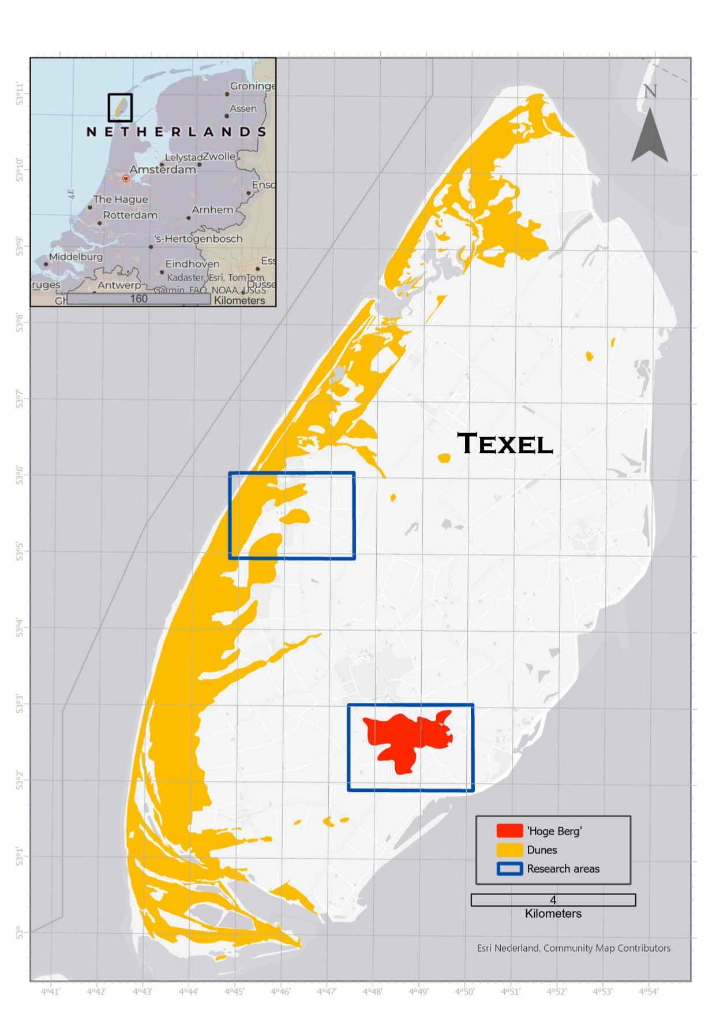
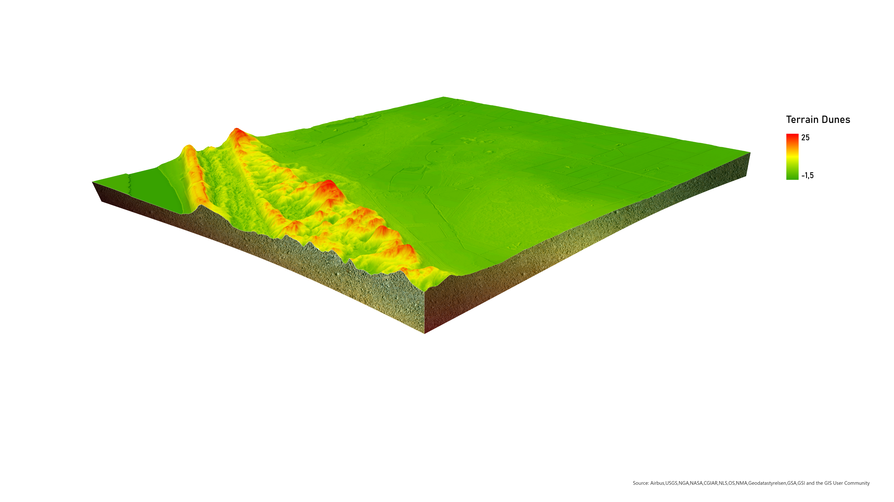
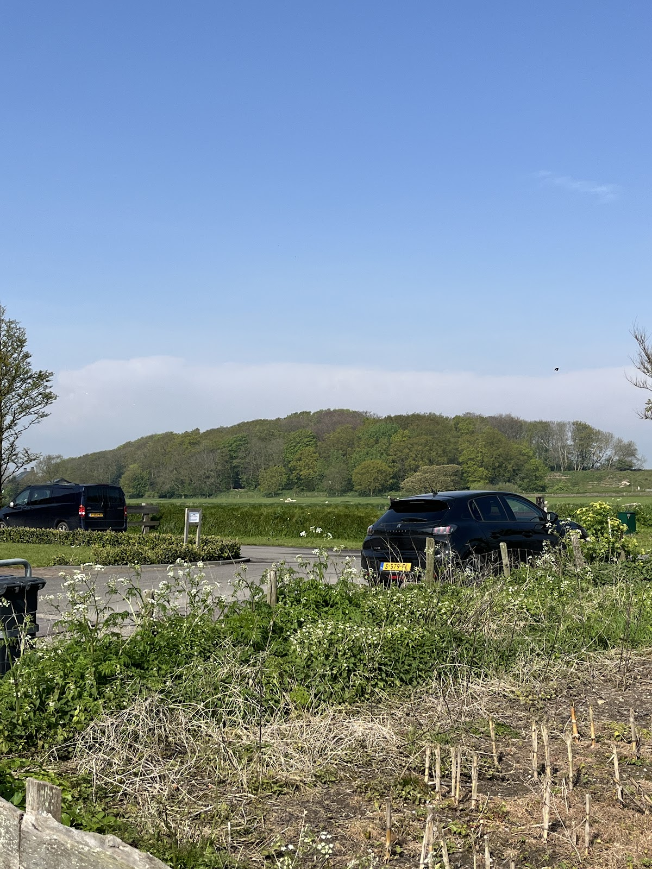
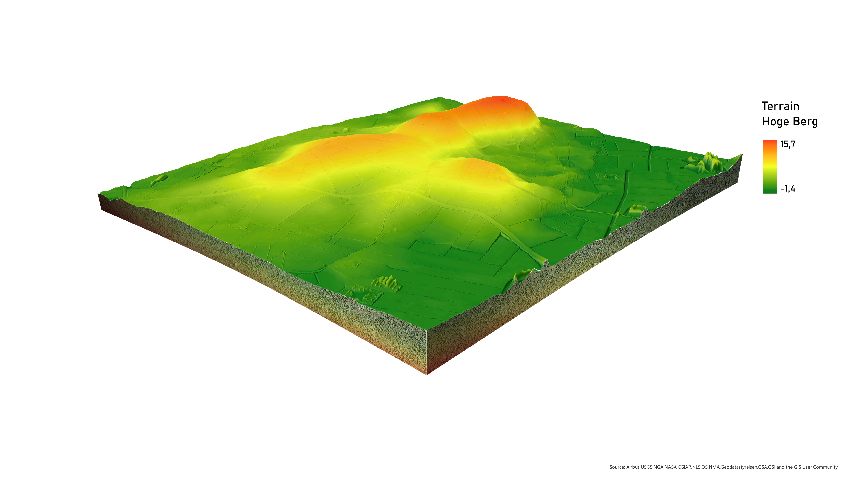
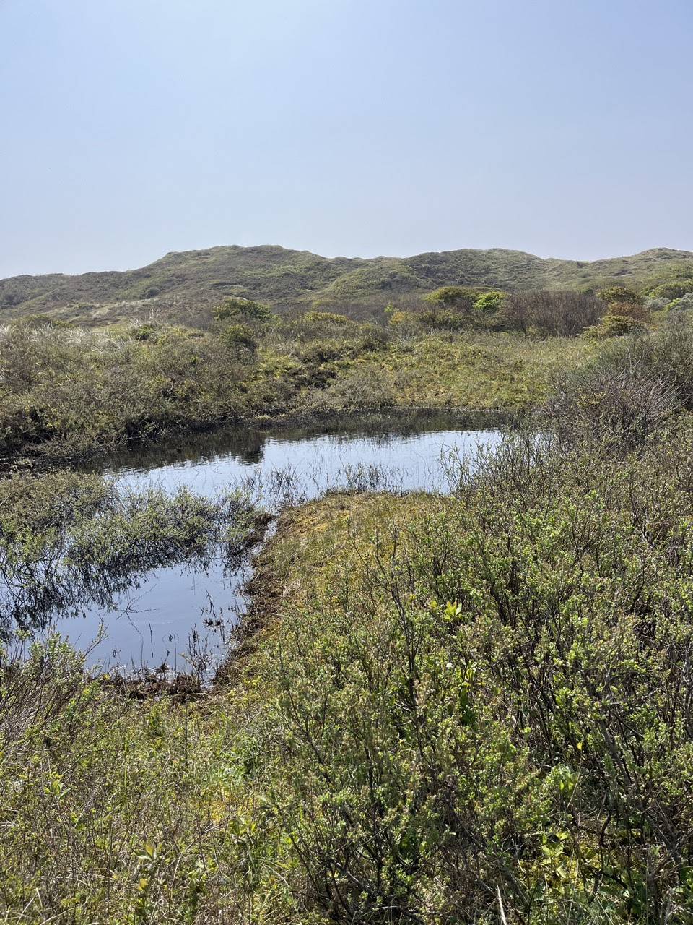
Study area
1. Introduction
2. Methodology
3. Results
4. Discussion
5. Conclusion
7

Slide 8
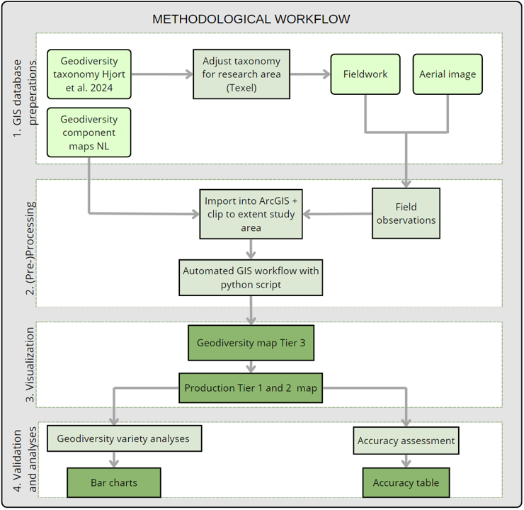
Workflow
1. Introduction
2. Methodology
3. Results
4. Discussion
5. Conclusion
8

Slide 9
Taxonomy Texel
1. Introduction
2. Methodology
3. Results
4. Discussion
5. Conclusion
9

Slide 10
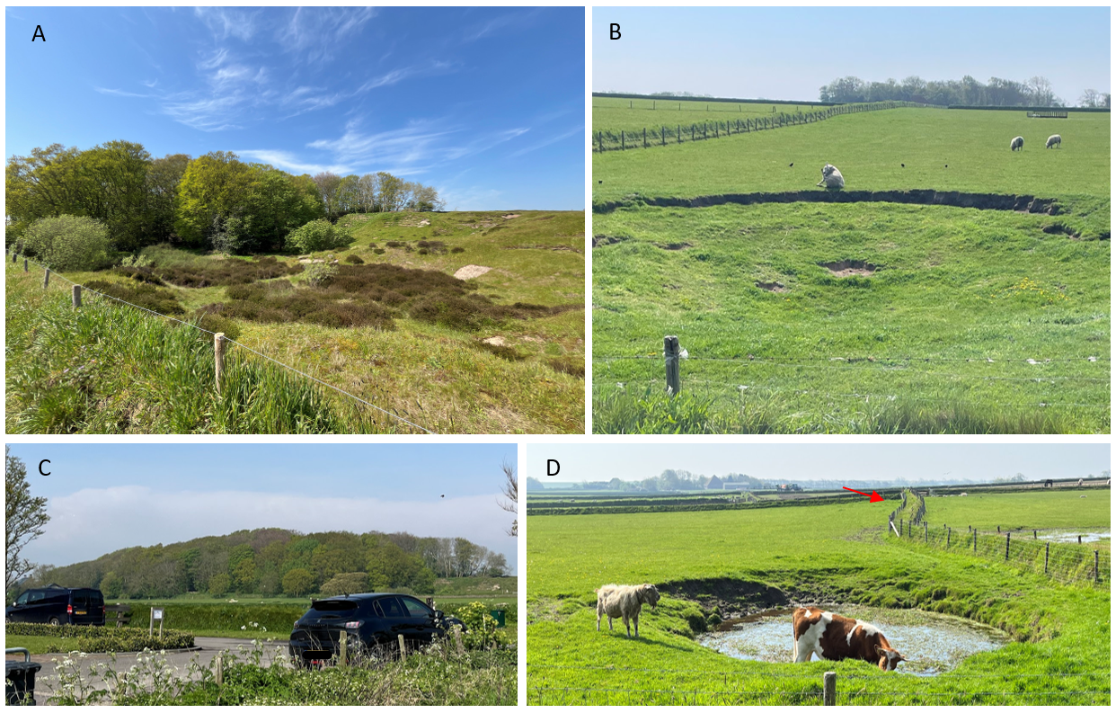
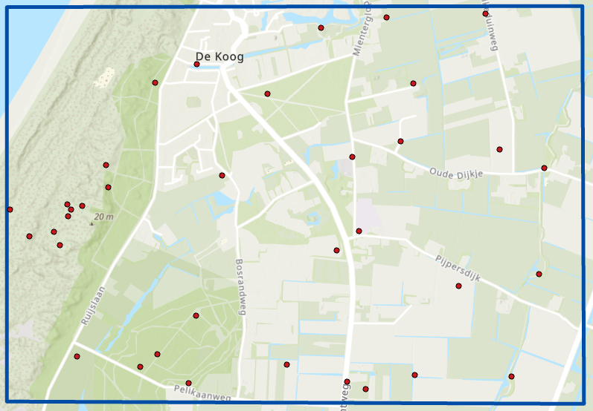
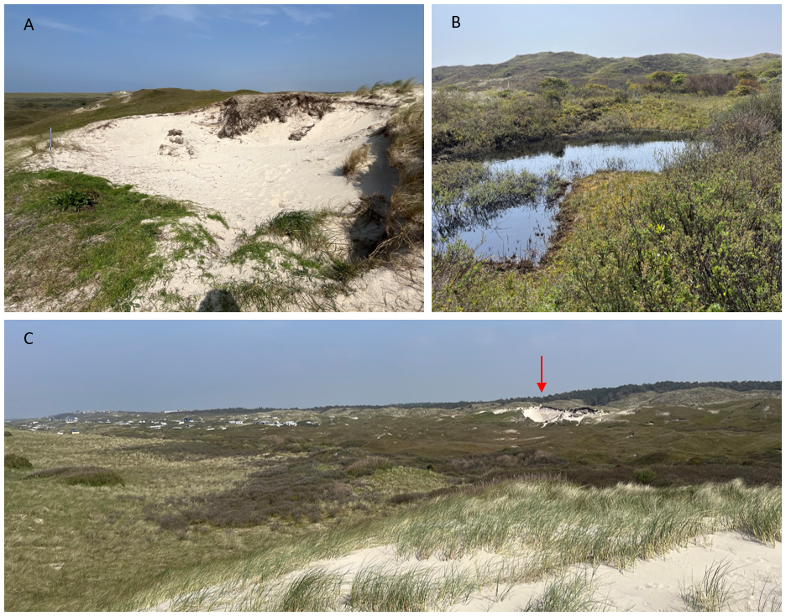
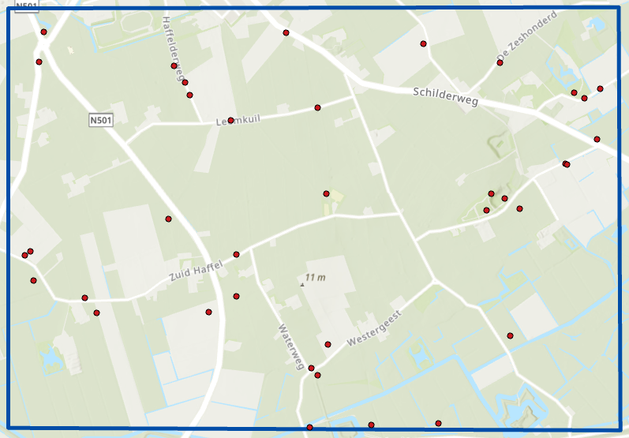
Fieldwork
1. Introduction
2. Methodology
3. Results
4. Discussion
5. Conclusion
10

Slide 11
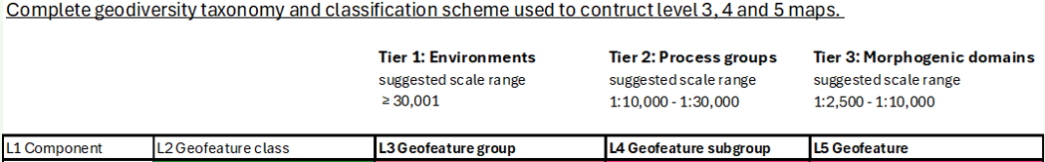
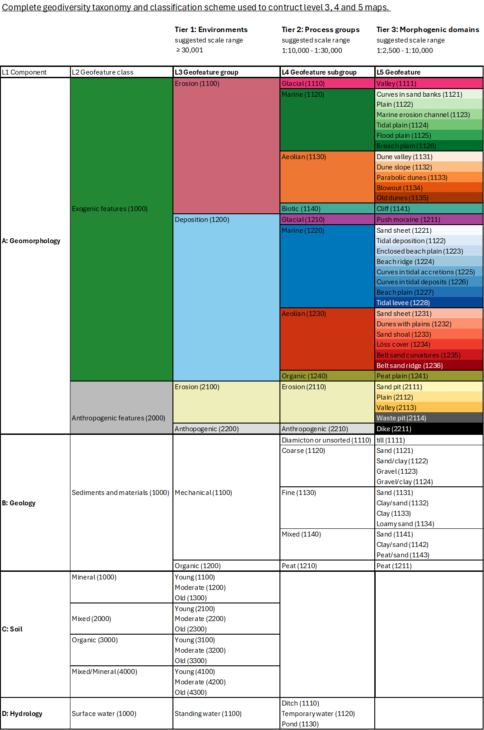
Hierarchical geodiversity map
1. Introduction
2. Methodology
3. Results
4. Discussion
5. Conclusion
11
Notes:
How map made. First highest detail level map made and then with GIS-codes other levels added. Great deal is taken into choice of colors and other visualizations.

Slide 12
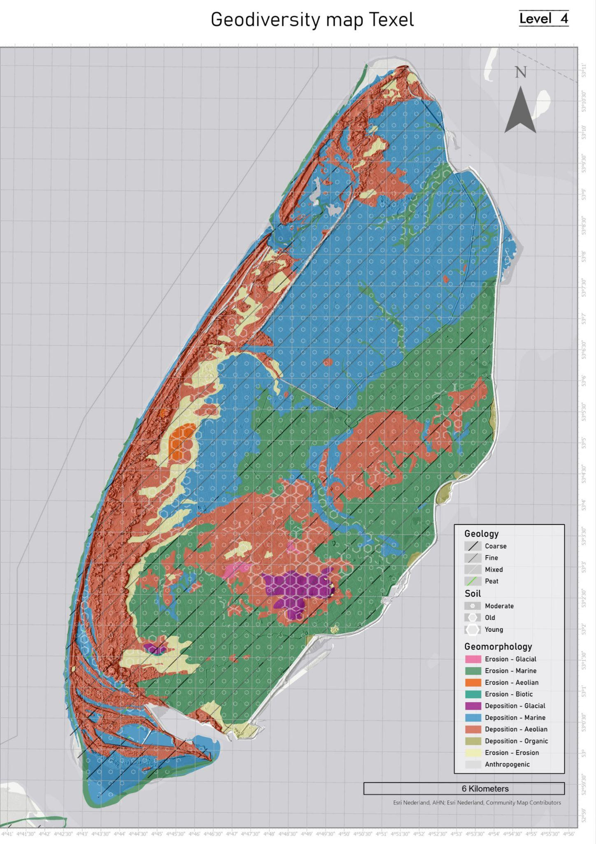
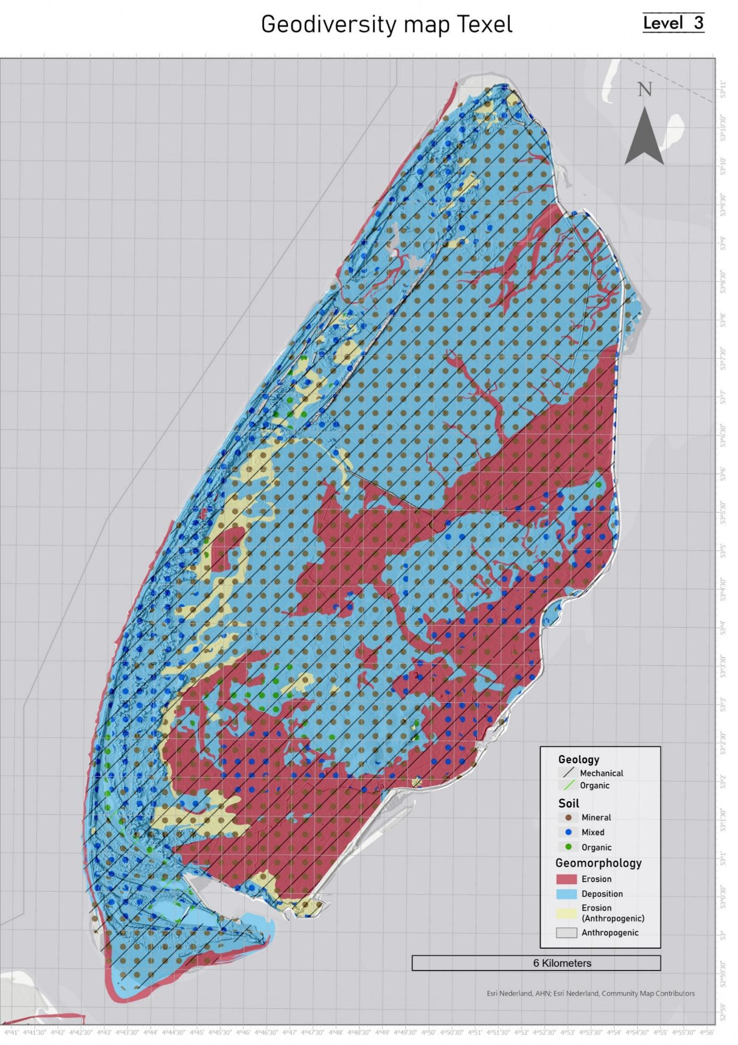
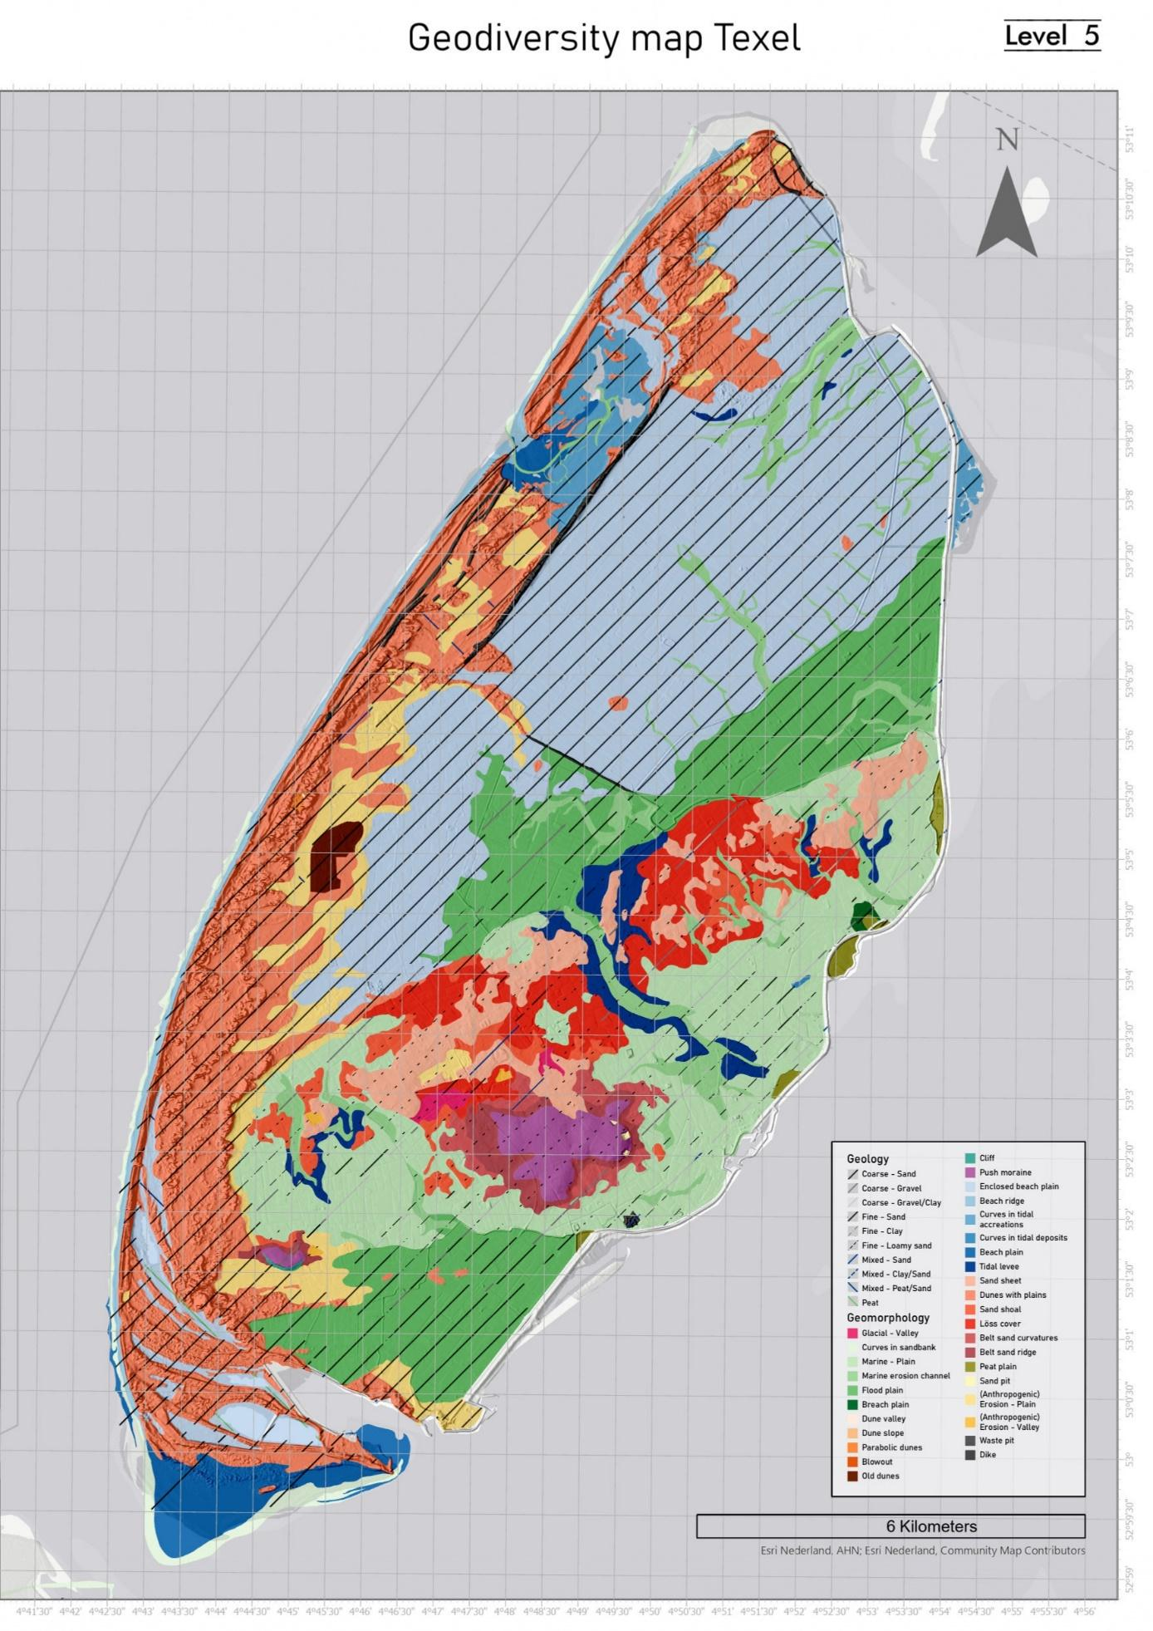
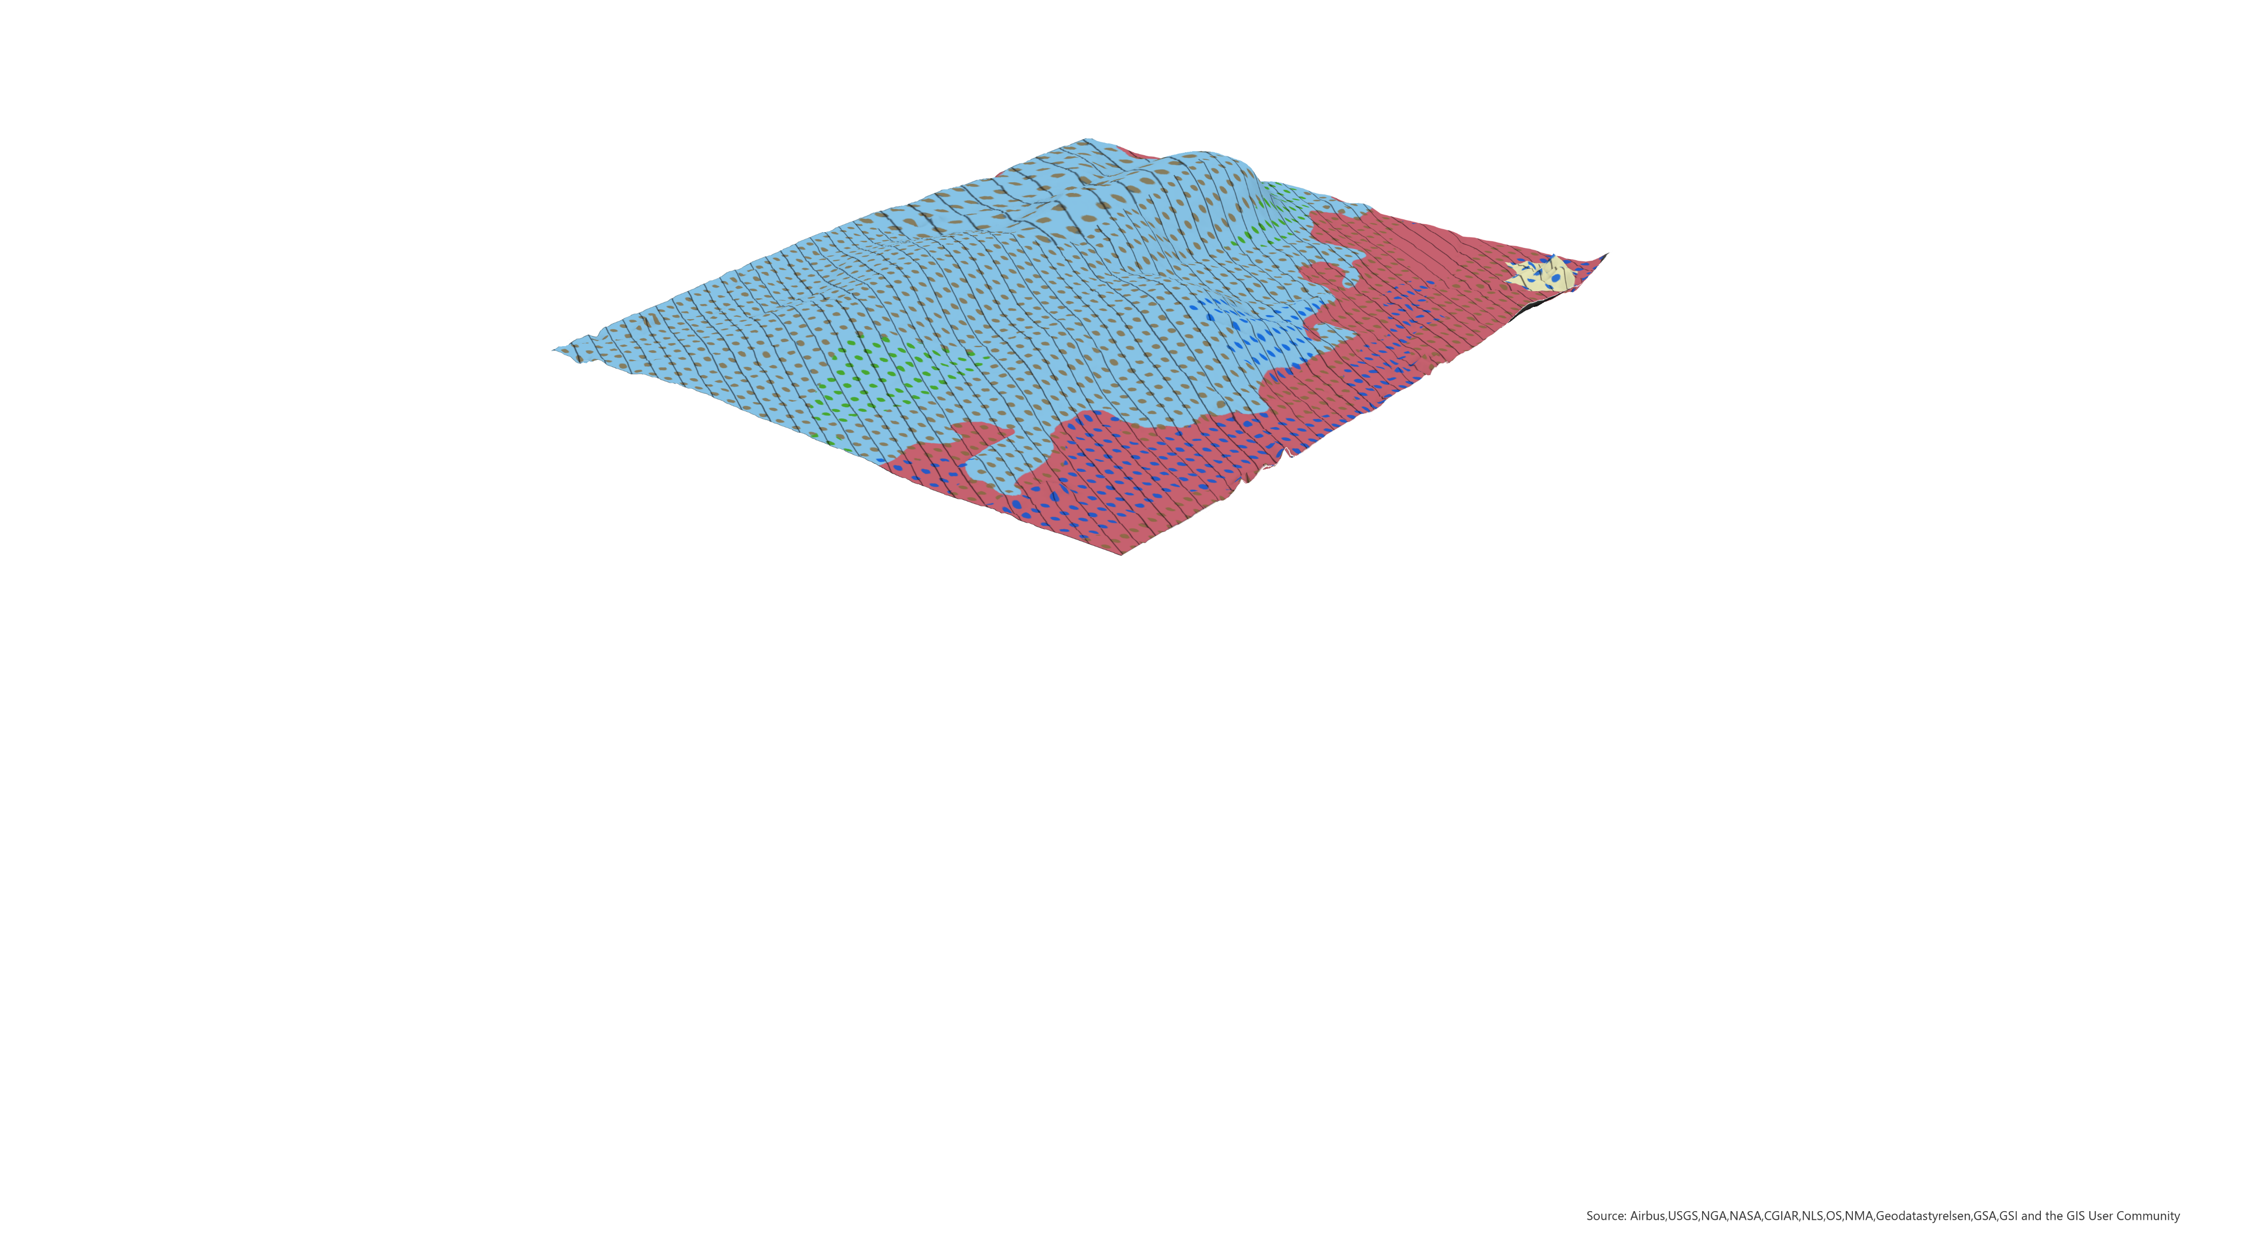
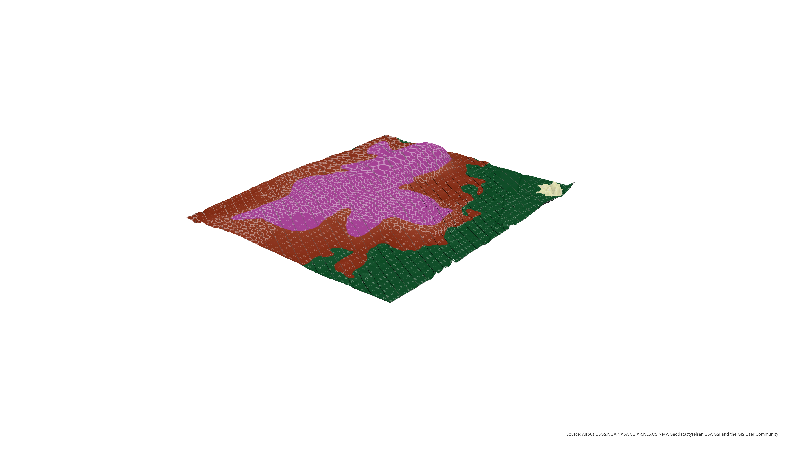
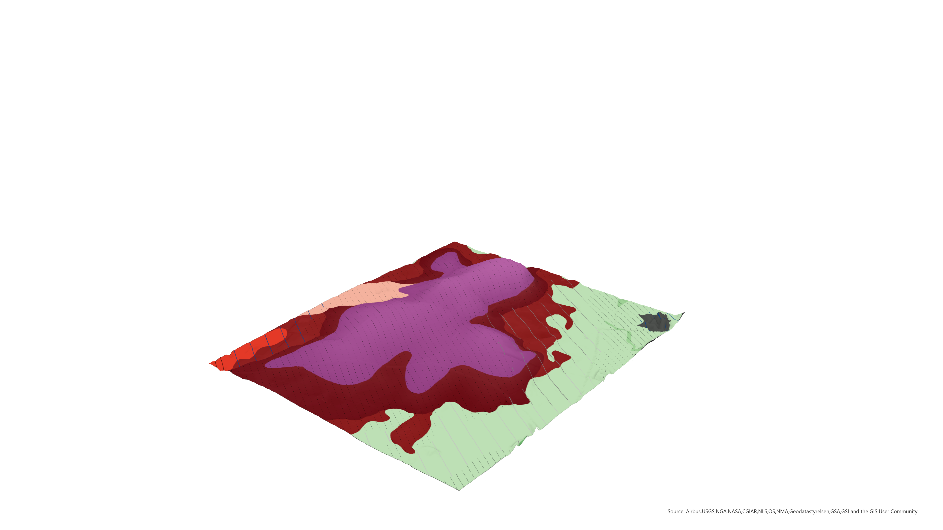
Hierarchical geodiversity map
1. Introduction
2. Methodology
3. Results
4. Discussion
5. Conclusion
12
10
Notes:
How map made. First highest detail level map made and then with GIS-codes other levels added. Great deal is taken into choice of colors and other visualizations.

Slide 13
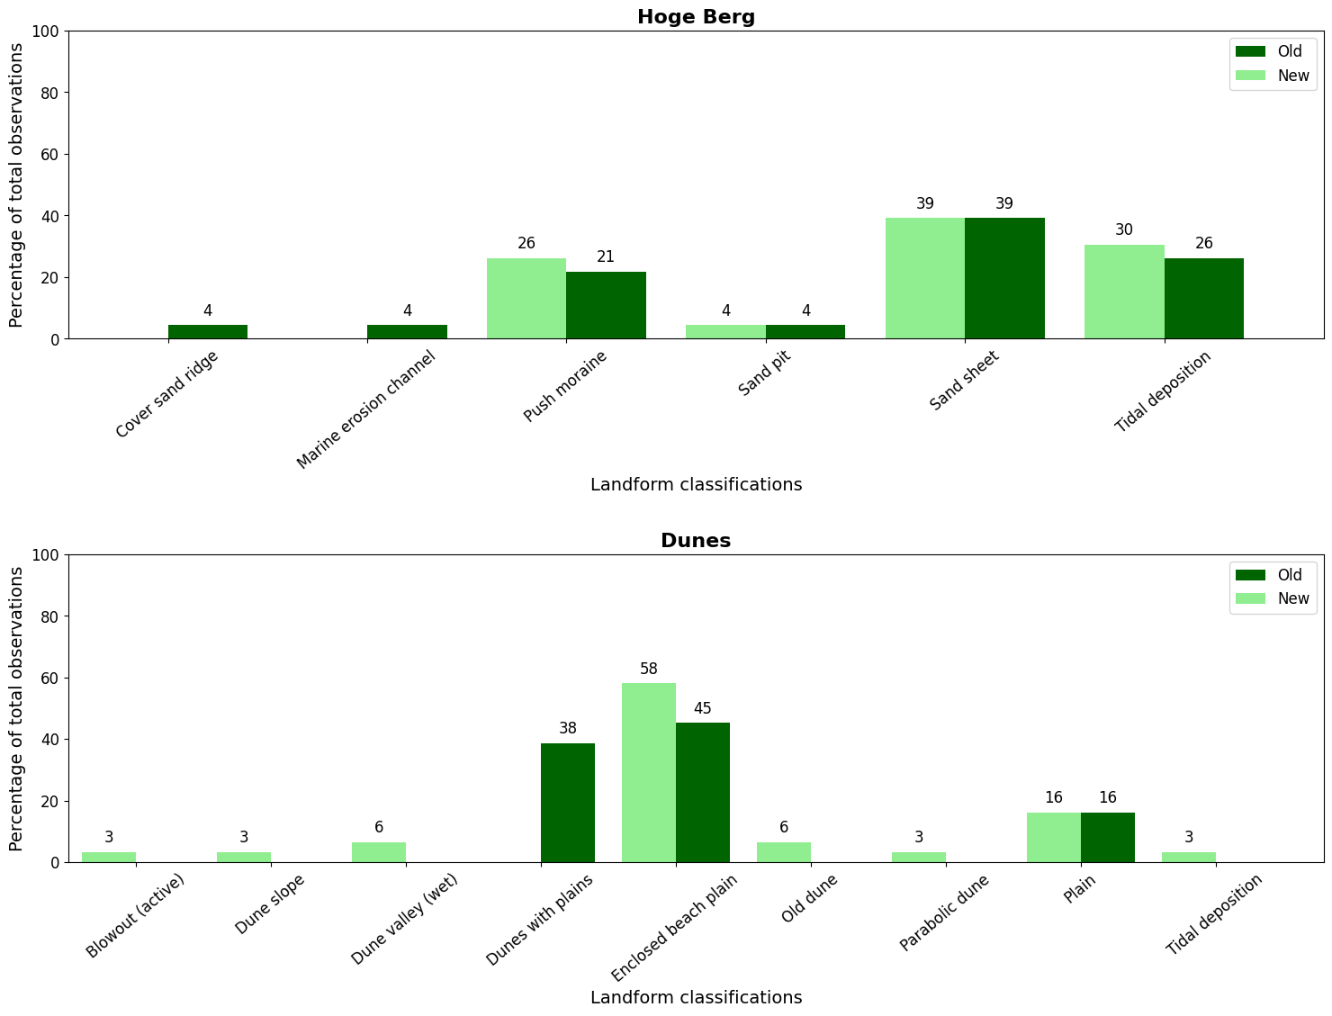
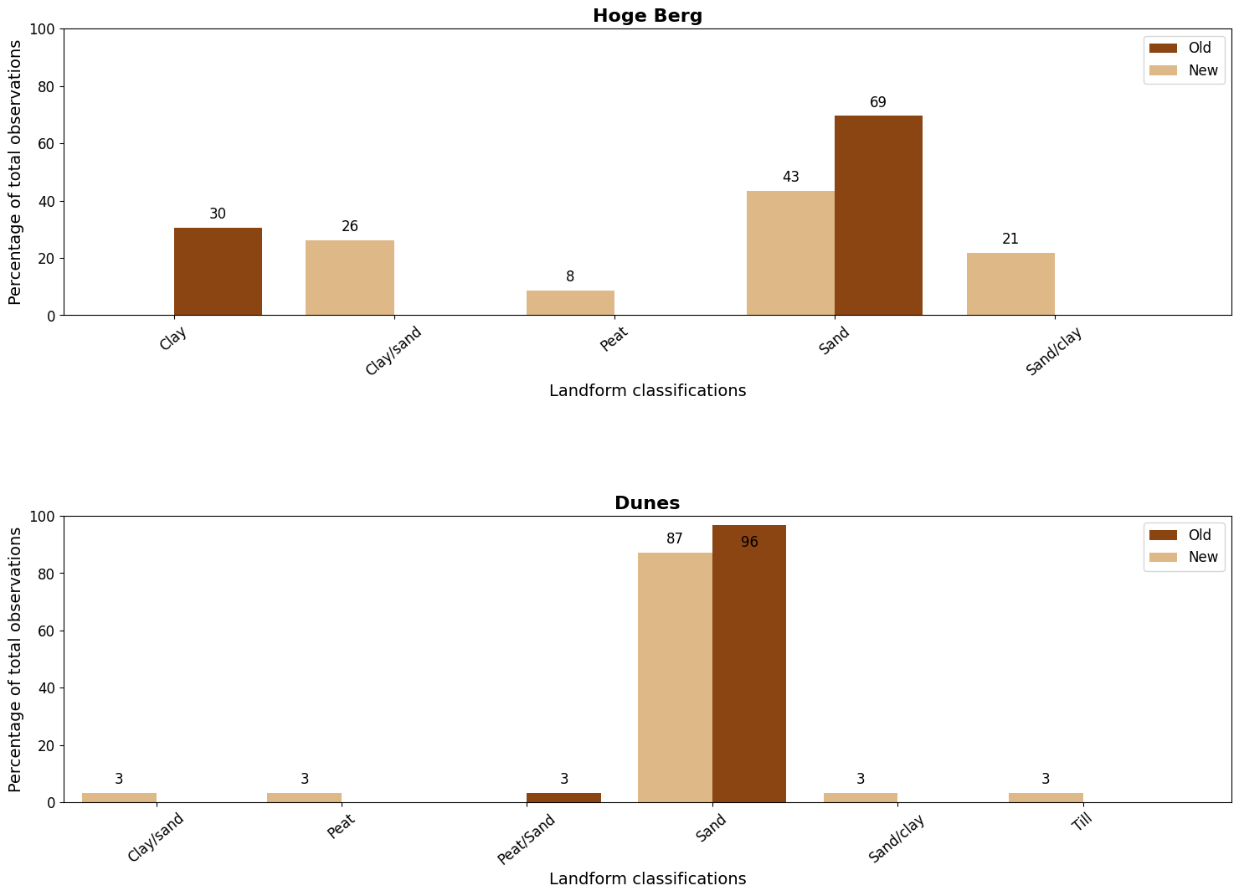
Geodiversity in the two case study areas
Geodiversity component | Accuracy Hoge Berg (%) | Accuracy Dunes (%) | Total observations HB | Total observations Dunes
Geomorphology | 87 | 61 | 27 | 31
Geology | 35 | 84 | 23 | 31
$$Accuracy score=\frac{Observed value}{Total value} × 100\%$$
1. Introduction
2. Methodology
3. Results
4. Discussion
5. Conclusion
13

Slide 14
Discussion
Interpretation of results
Hoge Berg higher geodiversity variety than dune area
Geofeatures are more even distributed in HB
Future research
Explore upscaling methodology to extent of Netherlands
Create standardized geodiversity databases or component maps
Workflow
Geomorphological and geological taxonomy adaptable to Texel
No suggested accuracy assessment
1. Introduction
2. Methodology
3. Results
4. Discussion
5. Conclusion
14

Slide 15
Conclusion
Research questions 1. Which taxonomic levels and features of Hjort et al. (2024) are necessary to map geodiversity of Texel island?
New systematic approach to map geodiversity hierarchically utilizing level 3 till 5 of the geodiversity taxonomy
1. Introduction
2. Methodology
3. Results
4. Discussion
5. Conclusion
15
Notes:
This research has yielded valuable insights into the visualization and distribution of geodiversity features in Texel. This approach has demonstrated its ability to show geodiversity features across different scales, providing a comprehensive view of landscape dynamics for the case study areas. However, further refinement and standardizations of the methodology are needed to enhance the applicability and accuracy of the geodiversity map. Conclusions: 1. 2.

Slide 16
Conclusion
Research questions 2. Which digital cartographic visualization tools and techniques adequately display geofeatures in a hierarchical geodiversity map?
Utilizing colorblind-friendly colors and different shapes and sizes enhances readability and usability of the map for people with color-vision impairment
1. Introduction
2. Methodology
3. Results
4. Discussion
5. Conclusion
15
Notes:
This research has yielded valuable insights into the visualization and distribution of geodiversity features in Texel. This approach has demonstrated its ability to show geodiversity features across different scales, providing a comprehensive view of landscape dynamics for the case study areas. However, further refinement and standardizations of the methodology are needed to enhance the applicability and accuracy of the geodiversity map. Conclusions: 1. 2.

Slide 17
Conclusion
Research questions 3. What geodiversity components and classes are present in the Hoge Berg and dune area?
The Hoge Berg area has a higher geodiversity variety compared to the dunes.
1. Introduction
2. Methodology
3. Results
4. Discussion
5. Conclusion
15
Notes:
This research has yielded valuable insights into the visualization and distribution of geodiversity features in Texel. This approach has demonstrated its ability to show geodiversity features across different scales, providing a comprehensive view of landscape dynamics for the case study areas. However, further refinement and standardizations of the methodology are needed to enhance the applicability and accuracy of the geodiversity map. Conclusions: 1. 2.

Slide 18

Questions?
Scan and see the dynamic version of the hierarchical geodiversity map!

